Slide 1
Determination of the Rate Constant for Metal Oxide Photocatalytic Dye Degradation
By Hugo Ramos

Slide 2
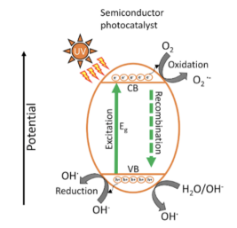
Research Aim
The goal of this research is to discover new heterogenous catalysts for dye degradation in Wastewater.
We want to use heterogeneous catalyst so that separation of the catalyst from the water is simple.
Our main aim is using metal oxides as they are relatively cheap and commonly used in photocatalytic processes [1].
Specifically, we are using metal oxides that are semiconductors as this will mean that the reaction will only happen when light is shown onto the catalyst.
Figure 1. Basic schematic representation of redox reactions that occur on the metal oxide surface for dye degradation [1]

Slide 3
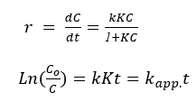
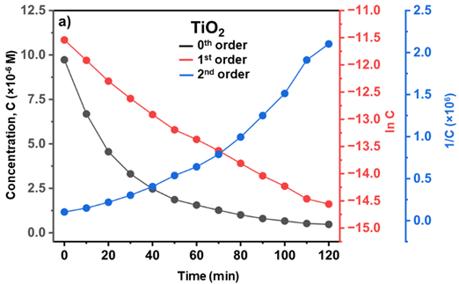
Theory
The main equation that is used to describe the kinetics of the previous reaction is the Langmuir-Hinshelwood Equation (Seen in the image of the top right) [2].
Previous work with Crystal Violet Dye had shown that the reaction order was 1st order so we will go off of that for the following examples.
This is seen in the plot in the bottom right corner which had an R² value of 0.983.
Figure 2. (Top right) Langmuir-Hinshelwood 1st Order Equation [2]
Figure 3. (Bottom right) TiO₂ Order Determination Plot

Slide 4
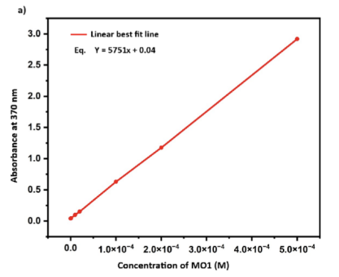
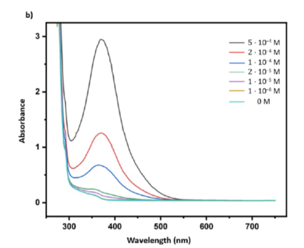
Theory
Figure 4. Calibration Curve for readings in the Tecan (UV vis) [1]
Figure 5. All wavelengths used to create Calibration Curve (Peak wavelength observed at 370 nm) [1]

Slide 5
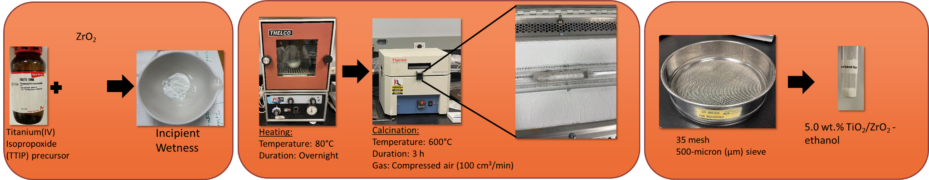
Experimental – Catalyst Creation
Figure 6. Catalyst Creation Walkthrough [3]

Slide 6
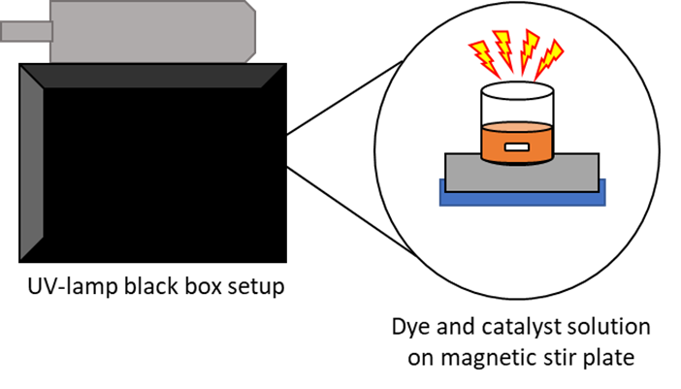
Experimental – Set-up
After the catalyst is made, it can be tested with the set-up displayed on the right.
The reaction is first allowed to stir in the dark for 1 hr so that the dye can adsorb onto the surface.
UV lamp is then turned on so that the reaction can take place for 2 hrs.
Every 10 minutes, a sample is centrifuged and then placed into the UV vis for testing to determine the current concentration of the solution.
Figure 7. Experimental Set-Up for Dye Decomposition [3]

Slide 7
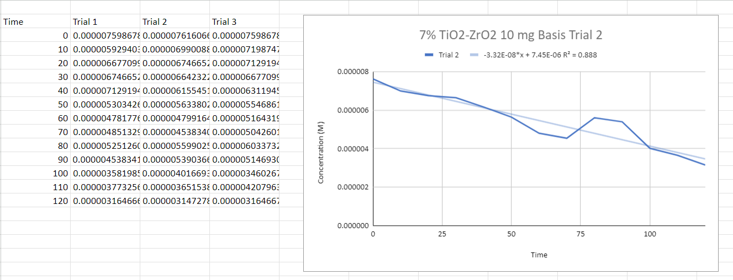
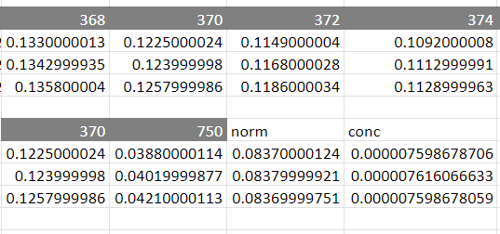
Old Methodology

Slide 8
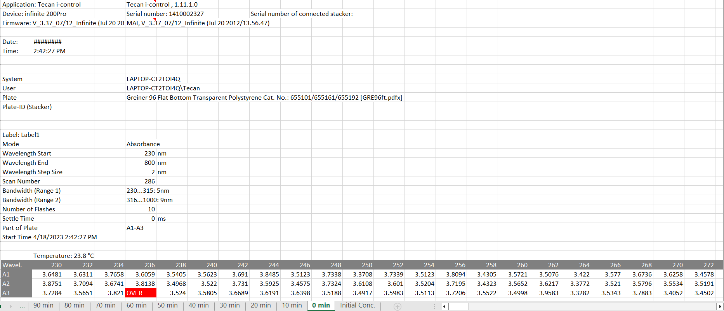
Snapshot of File

Slide 9
Coding Goals
The goals for the code
Extract Data from the Tecan Excel File that is produced.
Create a curve fit to 1st order based off the data obtained.
Plot to see how curve fitted equation lines up to experimental data.
Determine applicable rate constant, k_{app}, from curve fitted equation long with the corresponding R² value

Slide 10

Modules Used

Slide 11
Loading – Input File Name
Yep, It’s that Easy

Slide 12
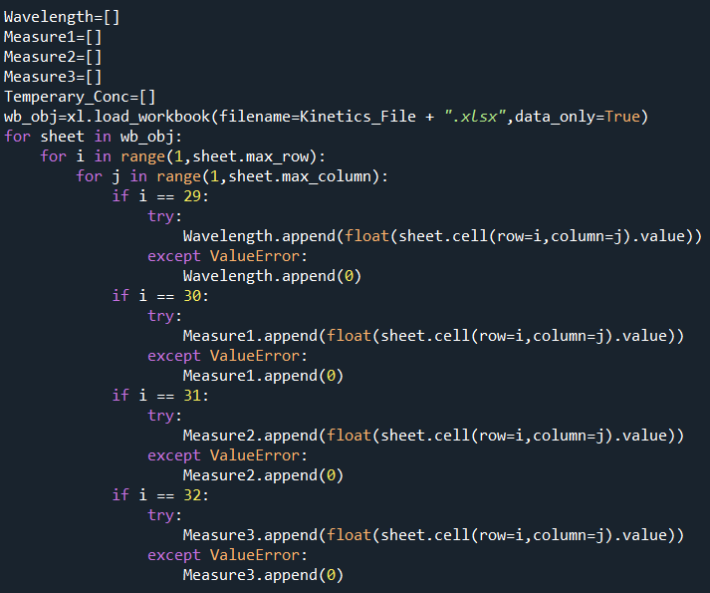
Loading – Downloading Data from Sheets
The code on the right cycles through each sheet to obtain the specific data needed.
A nested “for” loop is used in order to scan the rows and columns of data in the excel sheet
We know from the excel file that the data we need will always be found in rows 29, 30, 31, and 32.
Therefore, it extracts the data from the corresponding rows until the final column which is done by sheet.max_column.
The try: and except: statements are only triggered when it encounters a cell containing text.
Since we do not need these texts and they are not important, the code just replaces the text with a 0.

Slide 13
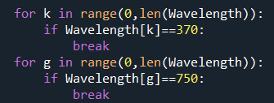
Selecting and Cleaning Data – Selecting Data from Specific Wavelength
Notes:
Take max value of wavelength instead of explicitly saying 370 nm and 750 nm. ->Can’t be done since 370 nm may not always be the max value.

Slide 14
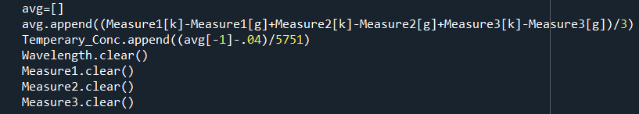
Selecting and Cleaning Data – Averaging and Converting to Concentration

Slide 15
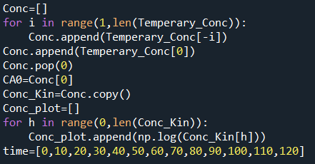
Plotting Kinetics - Creating Our Variables & Conversion to Logarithmic Scale

Slide 16
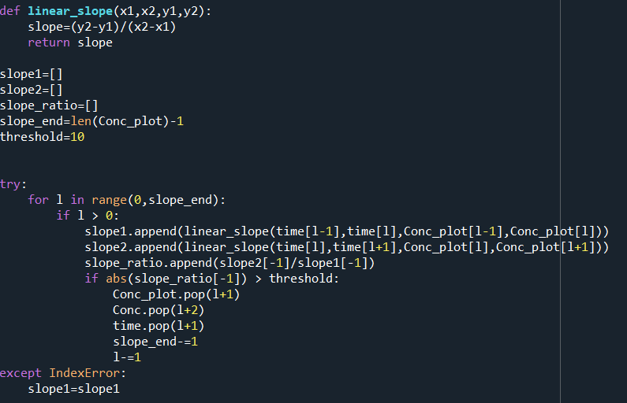
Selecting and Cleaning Data – Eliminating Outliers

Slide 17
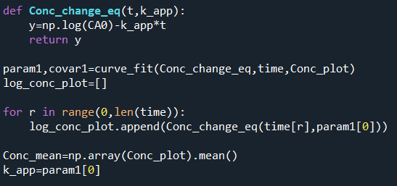
Creating Curve Fitting Model

Slide 18
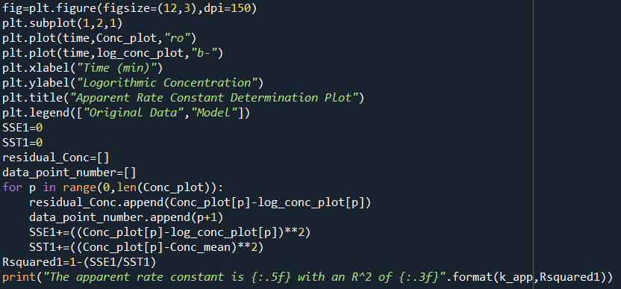
Plotting Kinetics – Actual Plotting

Slide 19
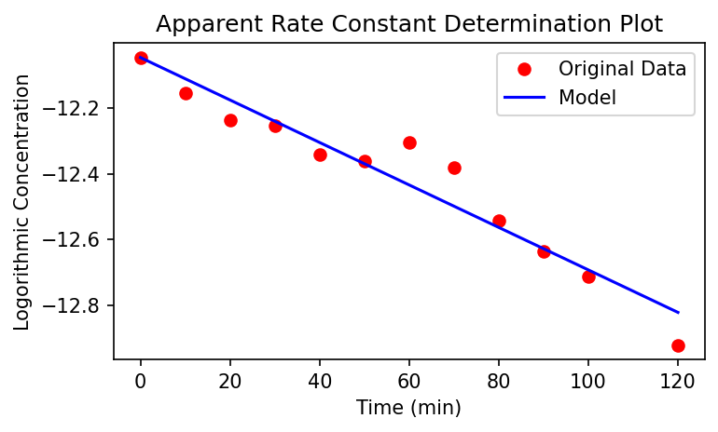
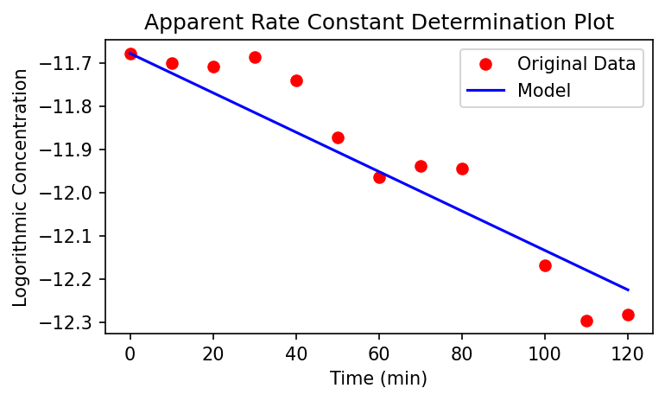
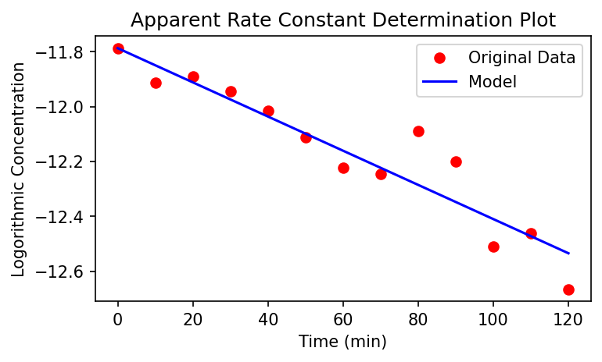
Final Results
3% TiO₂/Zr₂O₃
5% TiO₂/Zr₂O₃
7% TiO₂/Zr₂O₃
k_{app} = 0.00646 min⁻¹ , R² value = 0.930
k_{app} = 0.00456 min⁻¹ , R² value = 0.883
k_{app} = 0.00623 min⁻¹ , R² value = 0.882

Slide 20
Future Research Directions and Code Patch Notes
For Research:
Test other metal oxide catalysts to see how well they work
For Possibilities for Final Project Code V2:
Add Rate Order Determination Algorithm
Investigate other methods of “Goodness of Fit” to add to the code (Residuals Plot, Error Variance, etc.)

Slide 21
References
Sifat, M., Schevon, A., Ramos, H., & Shin, E. (2023). Photocatalytic Dye Decomposition of MO1 over TiO2 Metal Oxide-Based Catalysts. Journal of Undergraduate Chemical Engineering Research, 12, 50–60.
Konstantinou IK, Albanis TA. TiO2-assisted photocatalytic degradation of azo dyes in aqueous solution: Kinetic and mechanistic investigations. Applied Catalysis B: Environmental. 2004;49(1):1–14. https://doi.org/10.1016/j.apcatb.2003.11.010
Sifat, M., Schevon, A., Ramos, H., Shin, E., Pophali, A., Jung, H. J., Skocir, A., Schiros, T., Meng, Y., Halada, G., Kim, T (2022, November 13-18). Photocatalytic Dye Decomposition of Mordant Orange 1 (MO1) over TiO2 Metal Oxide-Based Catalysts [Poster Session]. American Institute of Chemical Engineers, Phoenix, AZ, United States. https://aiche.confex.com/aiche/2022/meetingapp.cgi/Paper/655615

